Slide 1
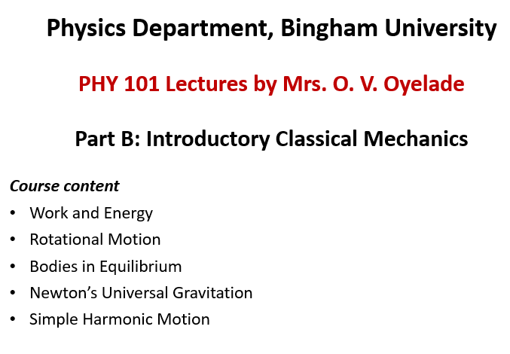

Slide 2
Bodies in Equilibrium

Slide 3
Bodies in Equilibrium
Learning Objectives
To understand the conditions for static equilibrium
To introduce the concept of the free-body diagram for rigid body
To show how to solve rigid-body equilibrium problems using the equations of equilibrium
To solve problems on center of gravity

Slide 4
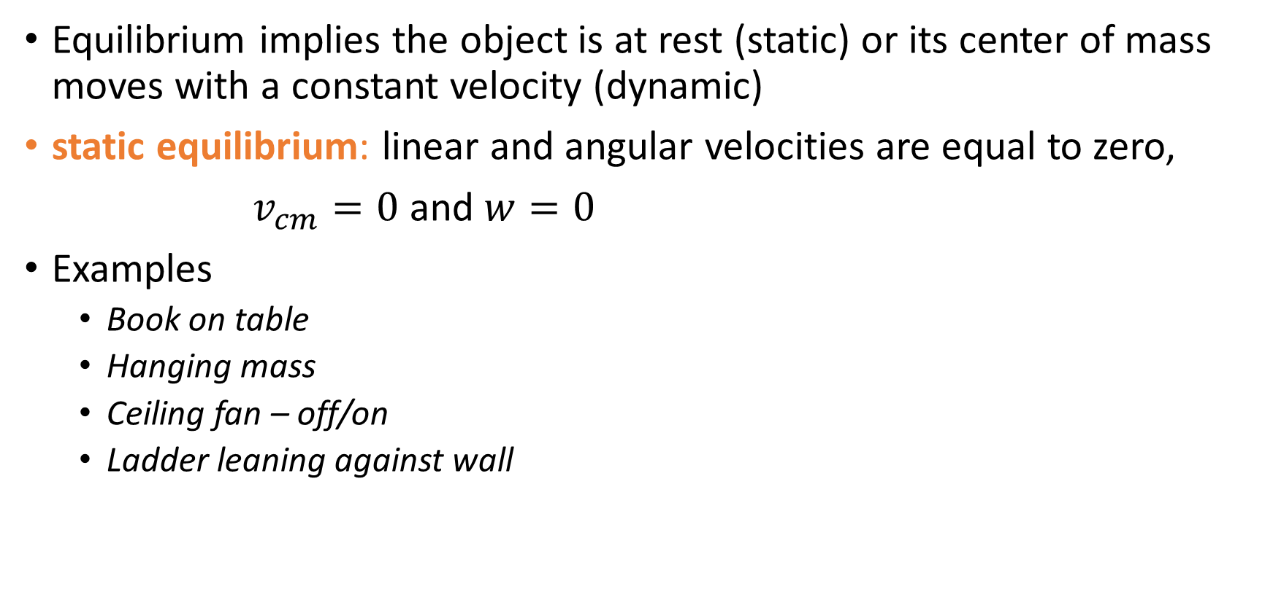
Equilibrium
Equilibrium implies the object is at rest (static) or its center of mass moves with a constant velocity (dynamic)
static equilibrium: linear and angular velocities are equal to zero,
$v_{cm}=0$ and $w=0$
Examples
Book on table
Hanging mass
Ceiling fan – off/on
Ladder leaning against wall

Slide 5


Conditions for Equilibrium
The first condition of equilibrium is a statement of translational equilibrium:
The net external force on the object must equal zero
This vector equation is equivalent to the following three scalar equations for the components of the net force:
It states that the translational acceleration of the object’s center of mass must be zero

Slide 6


Conditions for Equilibrium
The second condition of equilibrium is a statement of rotational equilibrium
The net external torque on the object must equal zero
This vector equation is equivalent to the following three scalar equations for the components of the net force:
It states the angular acceleration of the object to be zero. This must be true for any axis of rotation

Slide 7
Conditions for Equilibrium
If the object is modeled as a particle, then this is the only condition that must be satisfied
The net force equals zero
if the object cannot be modeled as a particle, this is needed
The net torque equals zero

Slide 8
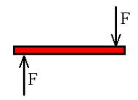
Static Equilibrium
Consider a light rod subject to the two forces of equal magnitude as shown in figure. Choose the correct statement with regard to this situation:
The object is in force equilibrium but not torque equilibrium.
The object is in torque equilibrium but not force equilibrium
The object is in both force equilibrium and torque equilibrium
The object is in neither force equilibrium nor torque equilibrium

Slide 9
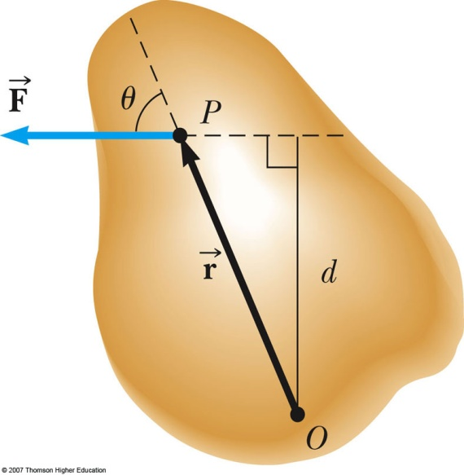
Equilibrium Equations
For simplicity, We will restrict the applications to situations in which all the forces lie in the xy plane.
Equation 1:
Equation 2:
There are three resulting equations

Slide 10
Free-body Diagram (FBD)
FBD is the best method to represent all the known and unknown forces in a system
FBD is a sketch of the outlined shape of the body, which represents it being isolated from its surroundings
Necessary to show all the forces and couple moments that the surroundings exert on the body so that these effects can be accounted for when equations of equilibrium are applied

Slide 11
Example
A uniform board of mass m_{pl} and length L supports two masses M and m. The support is under the center of gravity of the board, mass M is a distance d from the center, and the masse m is a distance 2.00 m from the center.
A) Find the magnitude of the upward force n exerted by the support on the board.
B) Find the position of M that will balance the system at rest.

Slide 12
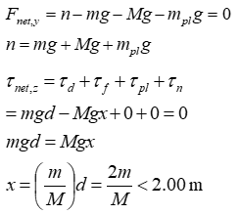
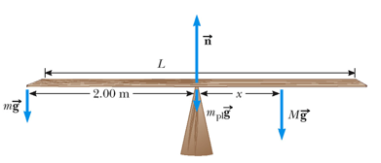
Solution to Example

Slide 13
Axis of Rotation
The net torque is about any axis in the xy plane
The choice of an axis is arbitrary
If an object is in translational equilibrium and the net torque is zero about one axis, then the net torque must be zero about any other axis
Choose a rotation axis to simplify problems

Slide 14
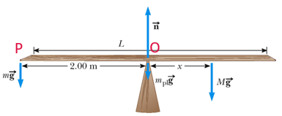
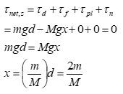
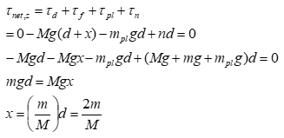
The position of M that will balance the system at rest

Slide 15
Center of Gravity
The torque due to the gravitational force on an object of mass M is the force Mg acting at the center of gravity of the object
If g is uniform over the object, then the center of gravity of the object coincides with its center of mass
If the object is homogeneous and symmetrical, the center of gravity coincides with its geometric center

Slide 16
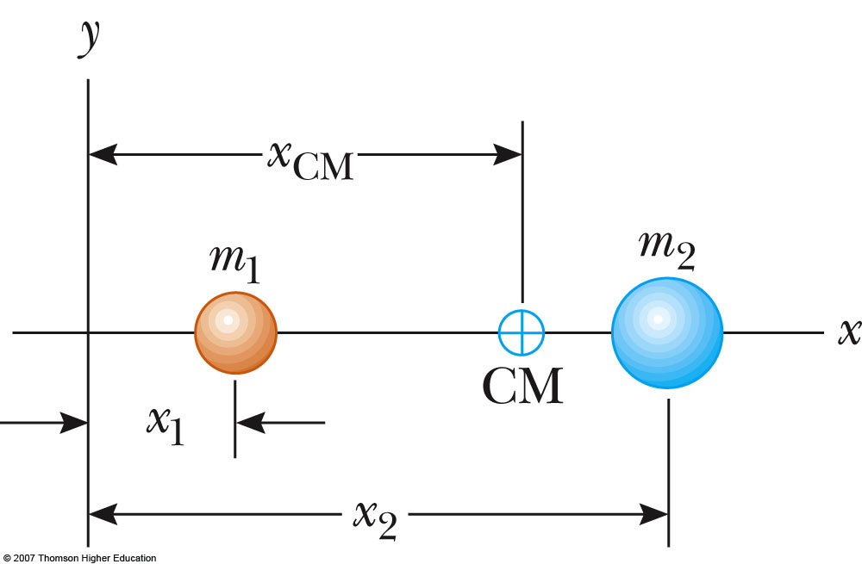
Where is the Center of Mass?
Assume m₁ = 1 kg, m₂ = 3 kg, and x₁ = 1 m, x₂ = 5 m, where is the center of mass of these two objects?
A) x_{CM} = 1 m
B) x_{CM} = 2 m
C) x_{CM} = 3 m
D) x_{CM} = 4 m
E) x_{CM} = 5 m

Slide 17
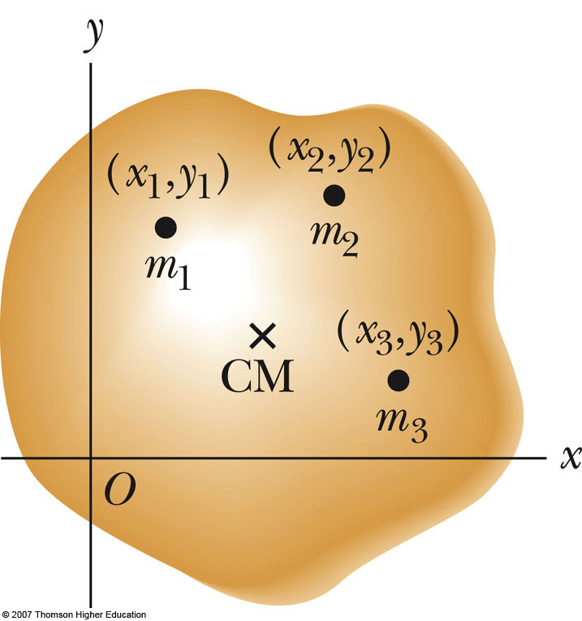
Center of Mass (CM)
An object can be divided into many small particles
Each particle will have a specific mass and
specific coordinates
The x coordinate of the center of mass will be
Similar expressions can be found for the
y coordinates

Slide 18
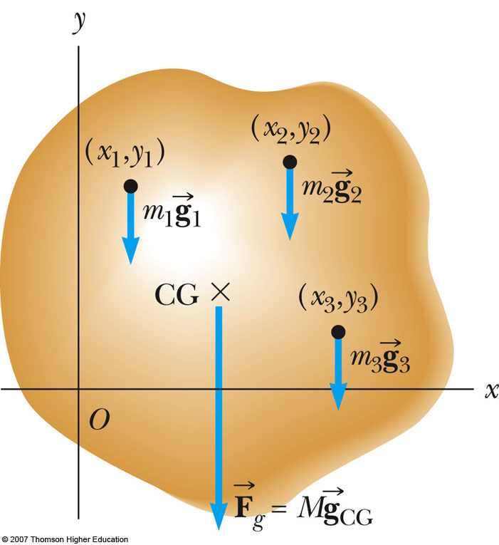

Center of Gravity (CG)
All the various gravitational forces acting on all the
various mass elements are equivalent to a single
gravitational force acting through a single point
called the center of gravity (CG)
If
then

Slide 19
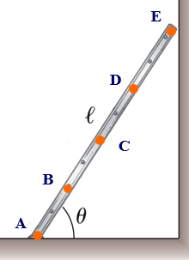
CG of a Ladder
A uniform ladder of length l rests
against a smooth, vertical wall. To
calculate the torque due to the
gravitational force, you have to find
center of gravity of the ladder. The
center of gravity should be located at
which of these points?

Slide 20
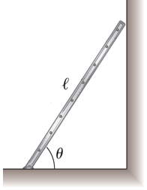
Example
A uniform ladder of length l rests against a
smooth vertical wall. The mass of the ladder
is m, and the coefficient of static friction
between the ladder and the ground is
μ_{s} = 0.40. Find the minimum angle θ at
which the ladder does not slip.

Slide 21
Problem-Solving Strategy 1
Draw a sketch, decide what is in or out the system
Draw a free body diagram (FBD)
Show and label all external forces acting on the object
Indicate the locations of all the forces
Establish a convenient coordinate system
Find the components of the forces along the two axes
Apply the first condition for equilibrium
Note: use correct force directions (i.e. + or -)

Slide 22
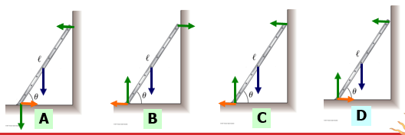
Which free-body diagram is correct?
A uniform ladder of length l rests against a smooth vertical wall. The mass of the ladder is m, and the coefficient of static friction between the ladder and the ground is μ_{s} = 0.40.
Forces - gravity: blue, friction: orange, normal: green

Slide 23
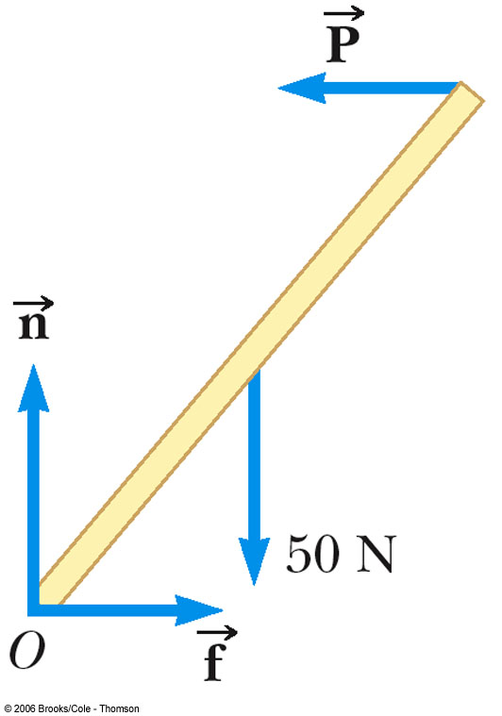
Example
A uniform ladder of length l rests against a smooth vertical wall. The mass of the ladder is m, and the coefficient of static friction between the ladder and the ground is μ_{s} = 0.40. Find the minimum angle θ at which the ladder does not slip.

Slide 24
Problem-Solving Strategy 2
Choose a convenient axis for calculating the net torque on the object
Remember the choice of the axis is arbitrary
Choose an origin that simplifies the calculations as much as possible
A force that acts along a line passing through the origin produces a zero torque
Be careful of sign with respect to rotational axis
positive if force tends to rotate object in counter clock wise direction (CCW)
negative if force tends to rotate object in clock wise direction (CW)
zero if force is on the rotational axis
Apply the second condition for equilibrium

Slide 25
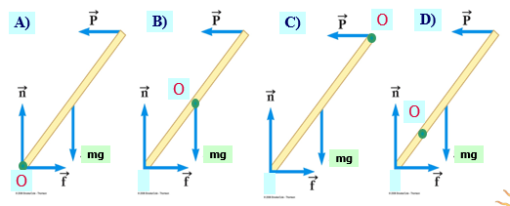
Choose an origin O that simplifies the calculations as much as possible ?
A uniform ladder of length l rests against a smooth, vertical wall. The mass of the ladder is m, and the coefficient of static friction between the ladder and the ground is μ_{s} = 0.40. Find the minimum angle.

Slide 26
A uniform ladder of length l rests against a smooth, vertical wall. The mass of the ladder is m, and the coefficient of static friction between the ladder and the ground is μ_{s} = 0.40. Find the minimum angle θ at which the ladder does not slip.
mg

Slide 27
Problem-Solving Strategy 3
The two conditions of equilibrium will give a system of equations
Solve the equations simultaneously
Make sure your results are consistent with your free body diagram
If the solution gives a negative for a force, it is in the opposite direction to what you drew in the free body diagram
Check your results to confirm

Slide 28
Exercises
Ex. 12 nos.: 25, 31, 32 and 33

Slide 29
References
University Physics Volume 1
L. Samuel @ 2016 OpenStax College
Physics: Principles with Applications
C. Giancoli @ 2014, Pearson, ISBN- 13:9780321625922
Physics at New Jersey Science & Technology University

